Slide 1

Event Management System
By
Sneha Yenduri
Nitin Sai Varma
Nikhil Godalla

Slide 2

Problem Definition and Solution
Our Event Management System is designed to bridge the communication gap among diverse organizations. By leveraging this platform, entities from various sectors can work in unison, performing interrelated tasks for a singular event. The system provides:
Unified Platform: A single interface where organizations can plan, communicate, and execute event-related activities.
Concurrent Task Management: Tools that allow multiple tasks to be carried out simultaneously, ensuring that all aspects of the event proceed smoothly and cohesively.
Real-Time Coordination: Instant updates and notifications keep all parties informed of the latest developments, facilitating immediate responses to dynamic event requirements.
Role-Specific Access: Customizable user roles and permissions to ensure that stakeholders have appropriate access to the information and functionalities pertinent to their responsibilities.
Collaborative Tools: Features that promote collaboration, such as shared calendars, task assignments, and progress tracking, to harmonize efforts towards the event's success.

Slide 3

Stakeholders
Host: They contribute by providing event details, schedules, and objectives to the system.
Event Organizers: They use the system to manage event logistics, registrations, and participant engagement.
Service Providers: Service providers offer various services, such as catering, audiovisual equipment, or transportation, to support events.
Venue Managers :Venue managers oversee event spaces and facilities.
Vendors: Vendors are businesses or individuals who sell products or services at events, like merchandise or concessions.
Guests :Guests are the individuals who attend events.

Slide 4

USE CASES
Wedding Management:
Scenario: A couple is planning their dream wedding, coordinating with multiple vendors and handling guest invitations.
Use-Cases:
Guest List Management: The couple can create and manage their guest list, send invitations, and track RSVPs.
Service Coordination: They can book service such as caterers, florists, photographers, and manage schedules.
Event Timeline: Gives a detailed timeline of all events.

Slide 5
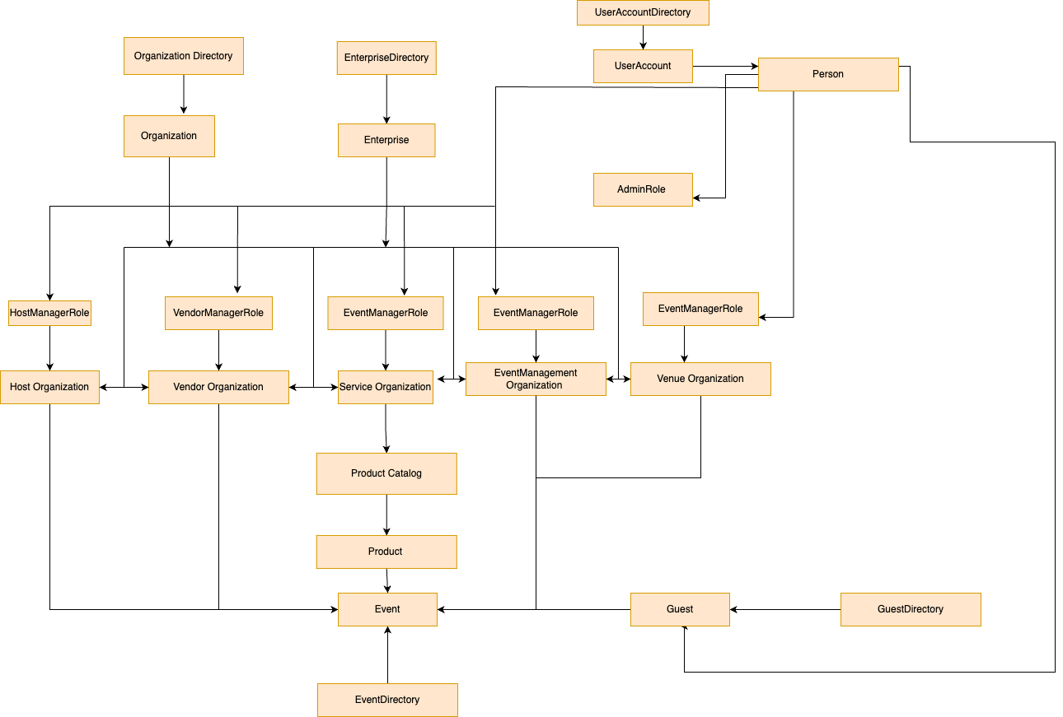
DESIGN

Slide 6
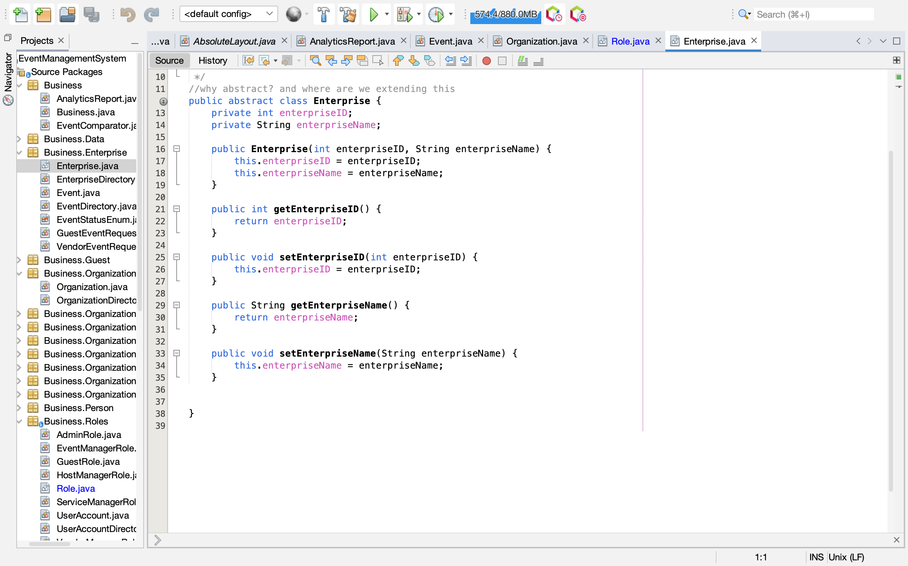
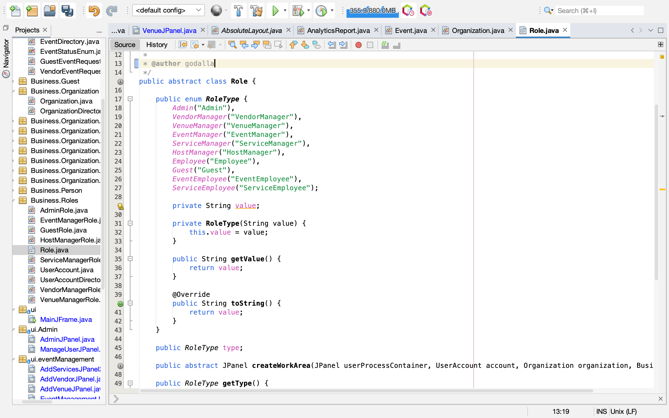
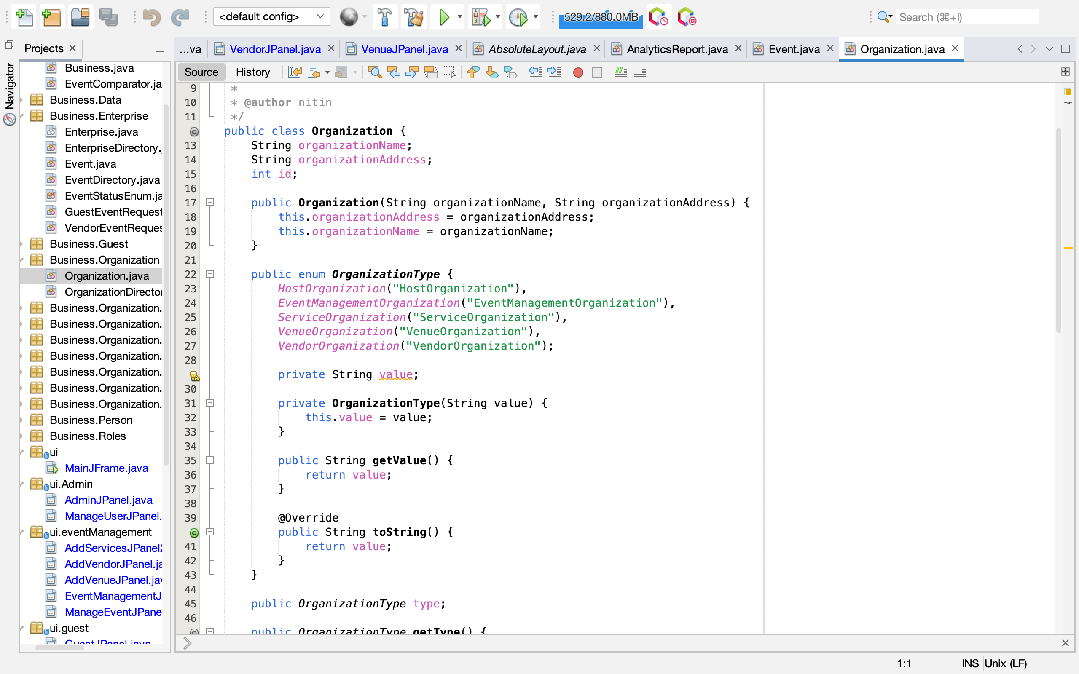
IMPLEMENTATION

Slide 7
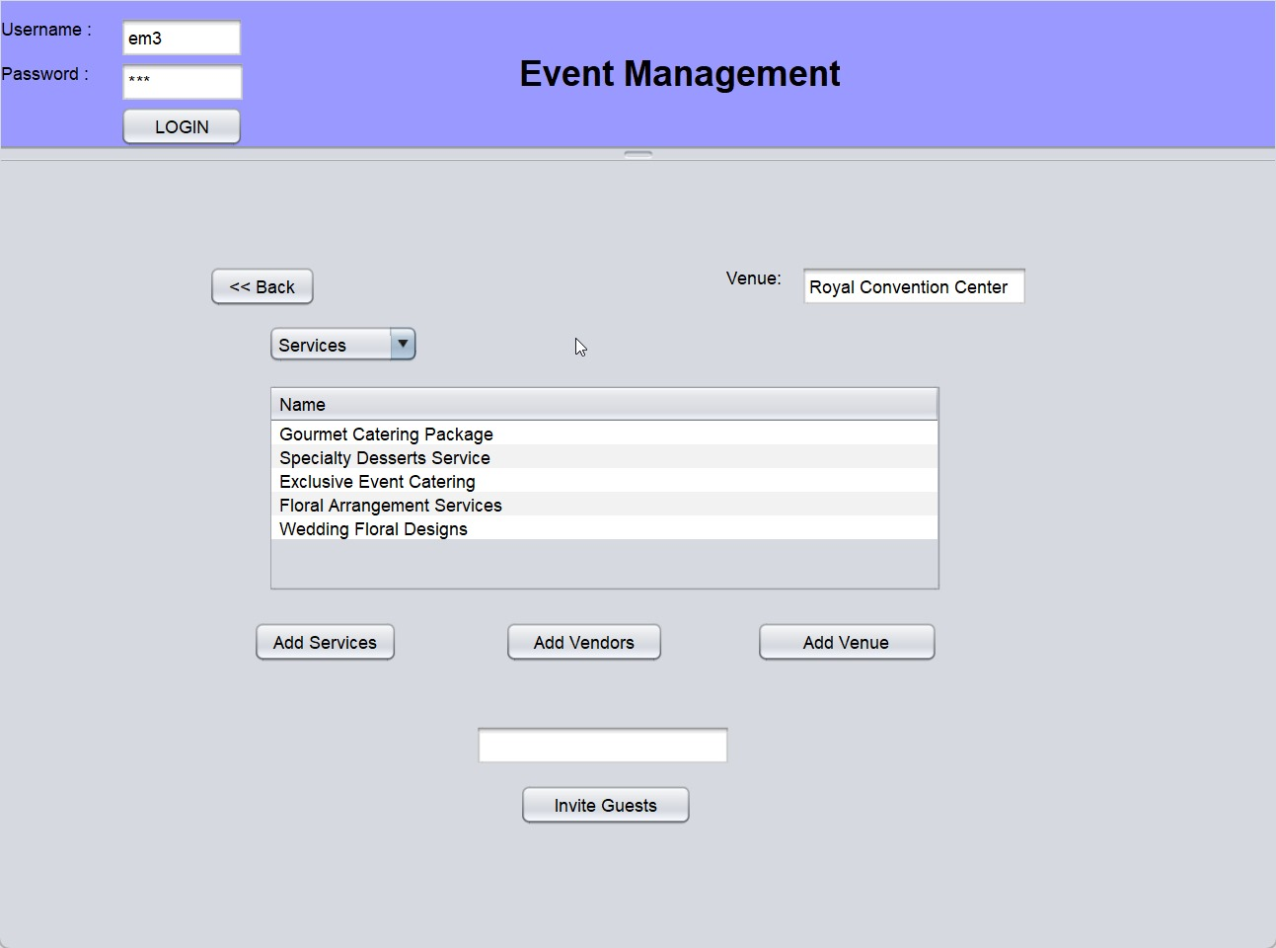
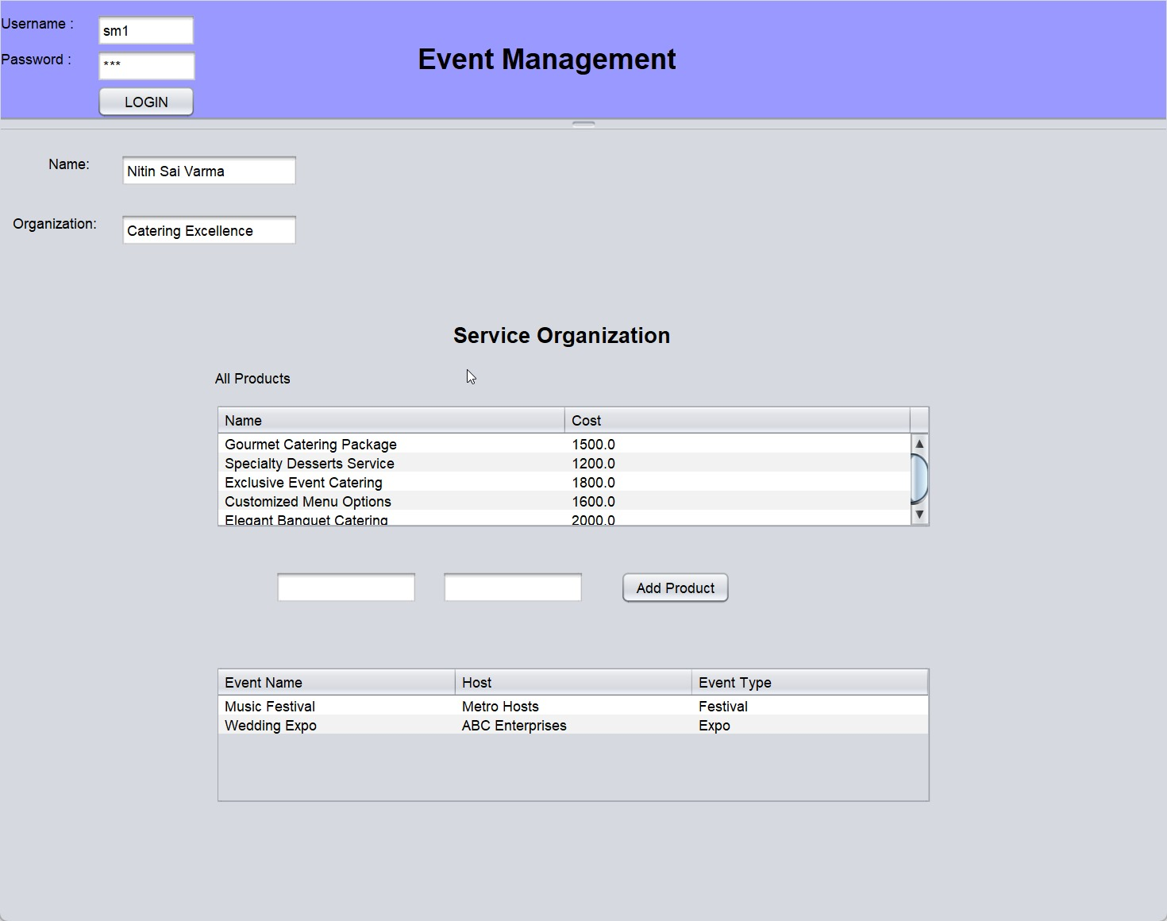
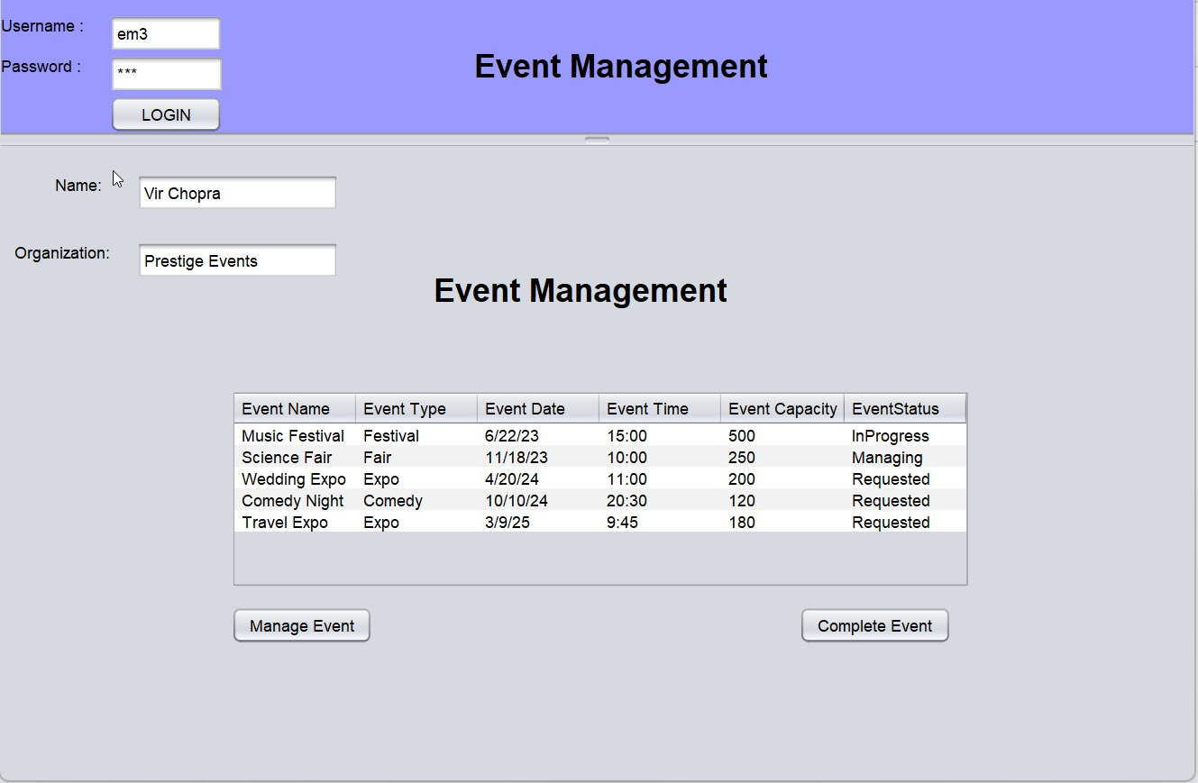
Working Model

Slide 8

THANK YOU

